Slide 1
Password Based Circuit Breaker

Slide 2
Password Based Circuit Breaker
What is Circuit Breaker?
Electrical circuit breaker is a switching device which can be operated manually as well as automatically for controlling and protection of electrical power system respectively.
As the modern power system deals with huge currents, the special attention should be given during designing of circuit breaker to safe interruption of arc produced during the operation of circuit breaker. This was the basic definition of circuit breaker.

Slide 3
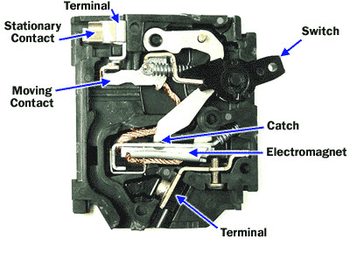
Password Based Circuit Breaker

Slide 4
Password Based Circuit Breaker
Introduction to Circuit Breaker:
The modern power system deals with huge power network and huge numbers of associated electrical equipment.
During short circuit fault or any other types of electrical fault these equipment as well as the power network suffer a high stress of fault current in them which may damage the equipment and networks permanently.
For saving these equipment and the power networks the fault current should be cleared from the system as quickly as possible.

Slide 5




Password Based Circuit Breaker
Again after the fault is cleared, the system must come to its normal working condition as soon as possible for supplying reliable quality power to the receiving ends.
The circuit breaker is the special device which does all the required switching operations during current carrying condition.
Nowadays, electrical accidents to the line man are increasing, while repairing the electrical lines due to the lack of communication between the electrical substation and maintenance staff.
This project gives a solution to this problem to ensure line man safety.
In this proposed system the control (on/off) of the electrical lines lies with line man help of a password.
http://www.edgefxkits.com/

Slide 6
Password Based Circuit Breaker
Block Diagram of Password Based Circuit Breaker:

Slide 7
Password Based Circuit Breaker
Principle of Password Based Circuit Breaker:
The main component in the circuit is 8051 microcontroller.
In this project 4×3 keypad is used to enter the password.
The password which is entered is compared with the predefined password. If entered password is correct then the corresponding electrical line is turned ON or OFF.
In this project a separate password is provided to each electrical line.
Activation and deactivation of the line (circuit breaker) is indicated by the load.

Slide 8
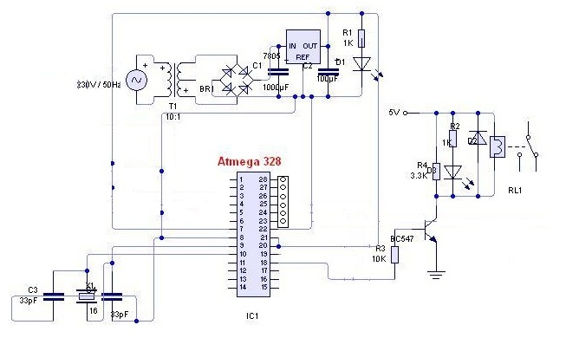
Password Based Circuit Breaker
Circuit Diagram of Password Based Circuit Breaker:

Slide 9
Password Based Circuit Breaker
How to Operate Password Based Circuit Breaker?
Write the program to the password based circuit breaker in keil software and create .hex file.
Burn program to the controller with help of flash magic.
Now give the connections as per the circuit diagram.
While giving the connections, make sure that there is no common connection between AC and DC supplies
Use 5V power supply circuit to provide regulated 5V DC to the controller.
Switch on the both AC and DC supplies.

Slide 10
Password Based Circuit Breaker
Now relay output pins gets 230v so do not touch the load connected pins.
LCD displays “enter password”.
Enter the password with help of keypad, you can see ‘*’ for each digit.
Now if the password is correct then circuit breaker state changes and displays line status on LCD.
If the password is wrong then displays “pwd is wrong”.
After some time asks to enter password.

Slide 11
Password Based Circuit Breaker
Hardware Requirements:
8051 series microcontroller
Relay driver IC
Relays
Matrix keypad
Crystal
Resistors
Capacitors
Diodes
Led
Transformer
Voltage regulator
Lamps

Slide 12
Password Based Circuit Breaker
Software Requirements:
Keil compiler
Language: Embedded C or Assembly

Slide 13
Password Based Circuit Breaker
Password Based Circuit Breaker Advantages:
Avoids electrical accidents to line man
Project is simple and easy
Uses commonly available components

Slide 14
Password Based Circuit Breaker
Password Based Circuit Breaker Applications:
Used in electrical substations to ensure line man safety
This system is used in buildings and houses
Used in hotels and shopping malls to save the power.

Slide 15
Password Based Circuit Breaker
Conclusion:
Password based circuit breaker control to ensure electric line man’s safety the pic microcontroller
This proposed system provides a solution, which can ensure the safety of the maintenance.
The control to turn on/off the line with the line man only

Slide 16
Password Based Circuit Breaker
Future Scope:
Further the project can be enhanced by using an EEPROM for user to change the password for a more secured system.
It can also be interfaced with a gsm modem for remotely controlling the electronic circuit breaker via sms

